Slide 1
DashDB & DataWorks

Slide 2
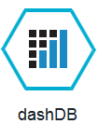
dashDB
Service | Use Case | Free Tier (30-day) Sizing | Entitled (Paid) Sizing
dashDB | Data warehousing and accelerated analytics | Includes perpetual free tier up to 1 GB stored data | Up to 20GB (Entry ) Dedicated instances from 64GB up to 256GB of data
Features
  Stores relational data for querying and advanced analytics
    Data mining
    Predictive Analytics
    Geospatial Analytics
  Powered by IBM BLU Acceleration and Netezza in-Database Analytics
    IBM BLU Acceleration is fast and simple. It uses dynamic in-memory columnar technology and innovations such as actionable compression to rapidly scan and return relevant data.
    In-database analytic algorithms integrated from Netezza bring simplicity and performance to advanced analytics.
Notes:
Use dashDB to store relational data, including special types such as geospatial data. Then analyze that data with SQL or advanced built-in analytics like predictive analytics and data mining, analytics with R, and geospatial analytics. You can leverage the in-memory database technology to use both columnar and row-based tables. The dashDB web console handles common data management tasks, such as loading data, and analytics tasks like running queries and R scripts.
You can also connect external applications and tools to dashDB and use them to further manage or analyze your data. For example: Connect IBM® InfoSphere® Data Architect to design and deploy your database schema.
Connect Esri ArcGIS to perform geospatial analytics and map publishing with your data.
Connect an IBM Cognos® server to run Cognos reports against your data.
Connect SQL-based tools such as Tableau, Microstrategy, or Microsoft Excel to manipulate or analyze your data.
Connect your Bluemix™ applications that need an analytics database.
Connect Aginity Workbench to migrate Netezza® data models and data to dashDB.

Slide 3
DashDB
IBM Analytics Warehouse is now IBM dashDB
This update introduces new capabilities-
  In-database analytic functions, which allow you to run analytics wherever that data resides within your warehouse. These analytic functions help accelerate your application performance when executing analytical queries. For example,
  You can use Geospatial libraries to load and access location data within IBM dashDB for analysis and visualization purposes.
  Integration of R-Studio, R language capabilities with RODBC and bluR packages to simplify access and sharing of R objects.
  leverage the in-memory database technology to use both columnar and row-based tables.

Slide 4
Key characteristics of an in memory columnar database service
In memory datastore that organizes data by columns instead of by rows
  Optimizes analytic workloads that require aggregation of a limited set of columns and a large numbers of rows
  The Bluemix service dashDB is an example of this type of service
    Powered by DB2 with BLU acceleration
    Leverages compression so more data can be stored in a given amount of memory
Notes:
An SQL database service provides applications access to relational databases that are queried using SQL. The SQL Database service in Bluemix is an example of an SQL data service that is powered by IBM DB2 and has a variety of features including high availability, automated backups and data privacy.

Slide 5
DashDB
You can also connect external applications and tools to dashDB and use them to further manage or analyze your data. For example: Connect IBM® InfoSphere® Data Architect to design and deploy your database schema.
Connect Esri ArcGIS to perform geospatial analytics and map publishing with your data.
Connect an IBM Cognos® server to run Cognos reports against your data.
Connect SQL-based tools such as Tableau, Microstrategy, or Microsoft Excel to manipulate or analyze your data.
Connect your Bluemix™ applications that need an analytics database.
Connect Aginity Workbench to migrate Netezza® data models and data to dashDB.

Slide 6
DashDB
dashDB web console overview
You can manage your dashDB database, analyze your data, and monitor sensitive data with the dashDB web console accessible from Bluemix. Launch the web console by clicking the service tile on your application overview page, and then click Launch. Single sign-on authentication connects you directly to the web console. You can access connection information from the web console, and the Downloads page includes links to client drivers for accessing dashDB from remote applications. You can also access sample data and reports.
Sensitive data
The dashDB web console includes a reporting feature powered by IBM InfoSphere Guardium® that detects and monitors sensitive objects (credit card numbers and US social security numbers) in the database. In the web console, select Monitor > Sensitive Data to run reports that identify columns that contain sensitive data and to monitor the connections and SQL statements that access those objects.

Slide 7
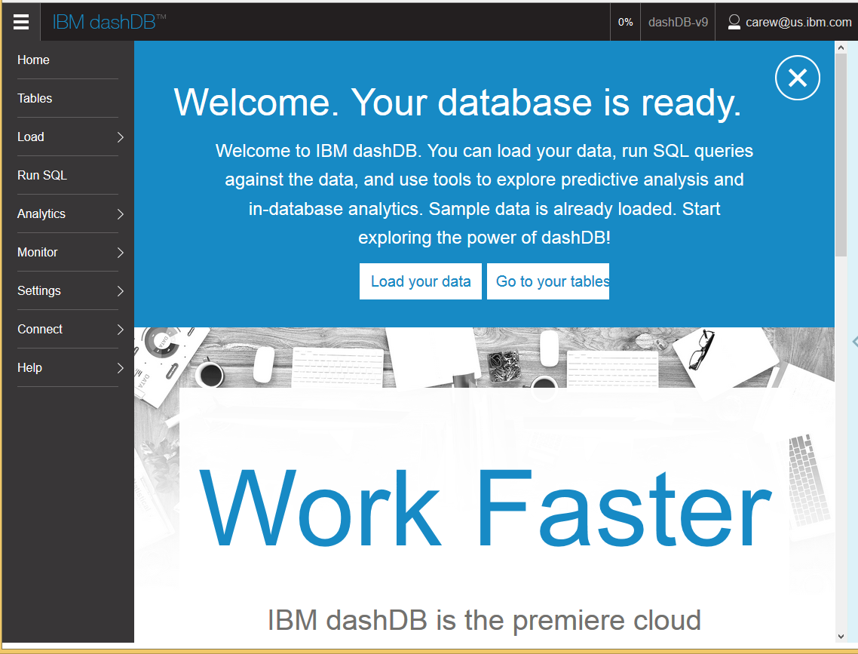
dashDB Console – Home
Notes:
Welcome page for dashDB console showing functionality grouped into categories at the left

Slide 8
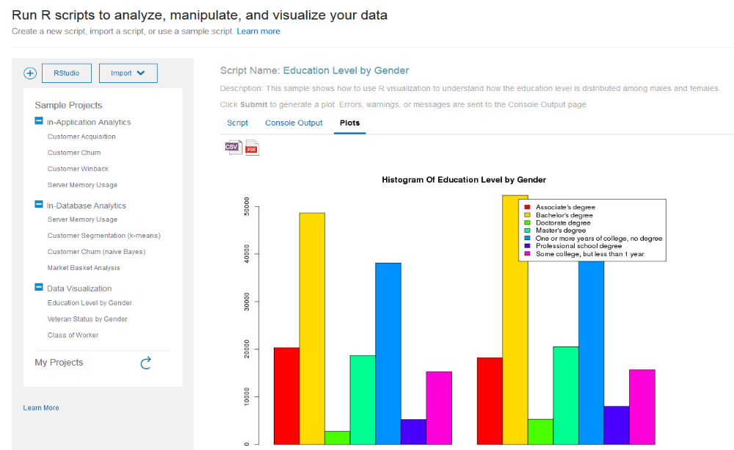
dashDB Console – Running R Scripts
Notes:
Example of running an R script from the dashDB console that creates a histogram of data stored in dashDB

Slide 9
IBM DataWorks
Introducing IBM DataWorks
As a brand new Beta offering on Bluemix, we are introducing IBM DataWorks. A service available as REST API, with the folowing functionality:
  Load data – move data from cloud sources to cloud targets.
  Cleanse addresses – Standardizes US address data. The Address Cleansing API is supported only in the United States Bluemix environment. It validates and improves the accuracy of location data by standardizing US addresses.
  Profile data – Classifies, Analyzes, and Validates data. gather information about data (such as data types), identify high value data attributes (such as national IDs), and classify data so you can take appropriate action – such as masking data before moving it.

Slide 10
DataWorks
In addition to the above capabilities, we are working on adding future capabilities, which can be expected soon:
  Provision masked data – mask sensitive data at the source while it is moved.
  Securely load data – access on-premises data from the cloud, using a secure gateway.
  Probabilistic match – match customer information within and across sources by using patented probabilistic fuzzy match algorithms.
In addition to the stand alone Bluemix service, IBM DataWorks services are also embedded within IBM Watson Analytics and are available with IBM dashDB.

Slide 11
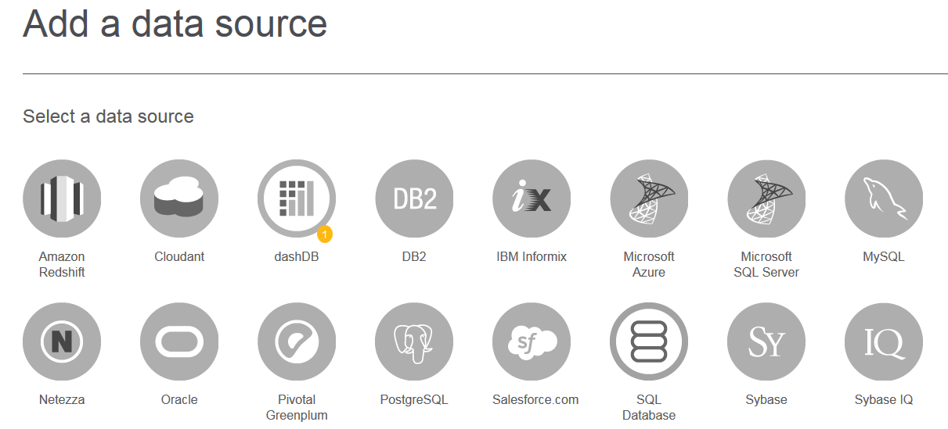
DataWorks

